Slide 1

E-LEARNING WEBSITE
With WEBRTC
TEAM MEMBERS-
ARCHANA K
SWETHA R

Slide 2
E-Learning
E-learning is a structured course or learning experience delivered electronically; it can also include performance support content.
There are also many different elements that can make up an e-learning program, such as live or pre-recorded lecture content, quizzes, simulations, activities, and other interactive elements.

Slide 3
EXISTING SYSTEM
The only video and audio conferencing options commonly available to educators and students today are those using proprietary systems. Each of these solutions requires additional software and often a completely standalone application to be installed. The setup time to establish each of these calls is usually quite high, and some of these solutions also require a licensing fee or setup cost.
With the introduction of WebRTC, it is now possible to skip all of these setup hurdles and seamlessly add video conferencing, screen sharing, and a whole host of other real-time interaction options to the existing web tools that the educators and students are already using.

Slide 4
TOOLS USED
FRONT END
BACK END
HTML
CSS
JAVASCRIPT
BOOTSTRAP
MY SQL
NODE.JS

Slide 5
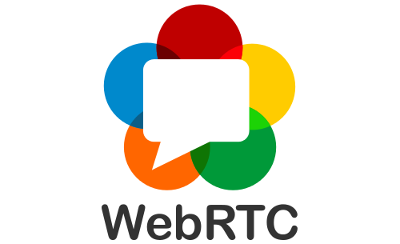
WEB RTC
WebRTC (Web Real-Time Communication) is a free and open-source project providing web browsers and mobile applications with real-time communication (RTC) via application programming interfaces (APIs). It allows audio and video communication to work inside web pages by allowing direct peer-to-peer communication, eliminating the need to install plugins or download native apps. Supported by Apple, Google, Microsoft, Mozilla, and Opera, WebRTC specifications have been published by the World Wide Web Consortium (W3C) and the Internet Engineering Task Force.

Slide 6
DESCRIPTION
HTML
HTML stands for Hyper Text Markup Language. HTML is the standard markup language for creating Web pages
CSS
CSS stands for Cascading Style Sheets. CSS describes how HTML elements are to be displayed on screen, paper, or in other media
JAVASCRIPT
JavaScript is the Programming Language for the Web. JavaScript can update and change both HTML and CSS. JavaScript can calculate, manipulate and validate data.
BOOTSTRAP
Bootstrap is the most popular CSS Framework for developing responsive and mobile-first websites. Bootstrap 5 is the newest version of Bootstrap.
MYSQL
MySQL is a database system used on the web. MySQL is a database system that runs on a server. MySQL is ideal for both small and large applications

Slide 7
NODE.JS
Node.js is a very powerful JavaScript-based platform built on Google Chrome's JavaScript V8 Engine.
It is used to develop I/O intensive web applications like video streaming sites, single-page applications, and other web applications.
Node.js is open source, completely free, and used by thousands of developers around the world.

Slide 8
WORKING
First a homepage is created.
Homepage consists of course names, login, register, log out.
After the selection of course name, video content of that particular course will be displayed.
After the completion of each video, puzzles will be given to solve.
A discussion group will be provided for each course so that they can discuss with others.
The latest technology news will be provided related to the particular course.

Slide 9
BLOCK DIAGRAM
WATCH
COURSE
VIDEOS
SELECT
COURSE
REGISTER
LOG IN
GET LATEST
TECH-NEWS
ATTEND DISCUSSION
SESSIONS
COMPLETE
PUZZLES

Slide 10

ADVANTAGES
ACCESSIBILITY & TIME SAVING
EASY REFRESH OF CONTENT
TRACKING LEARNING ACTIVITIES
EASY REFRESH OF CONTENT
SCALABLE & EFFICIENT

Slide 11
THE END

